Slide 1
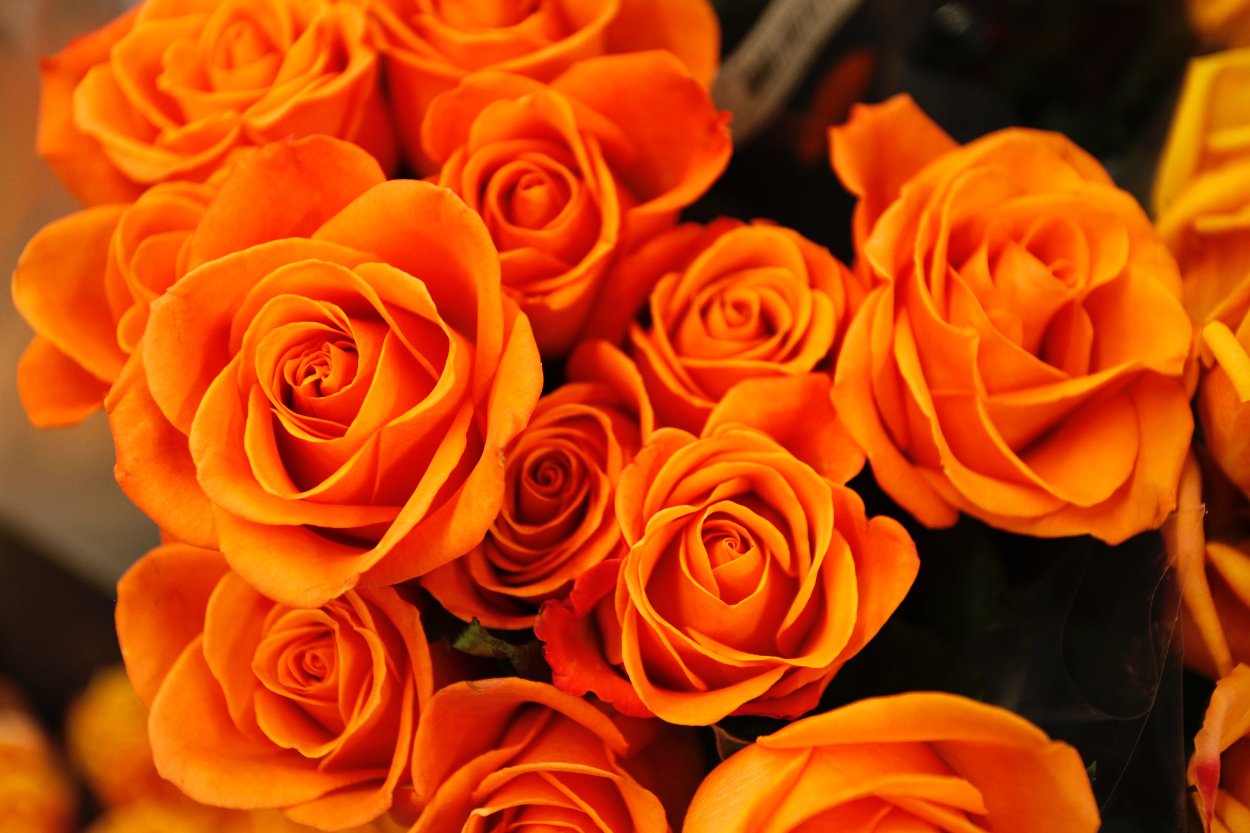
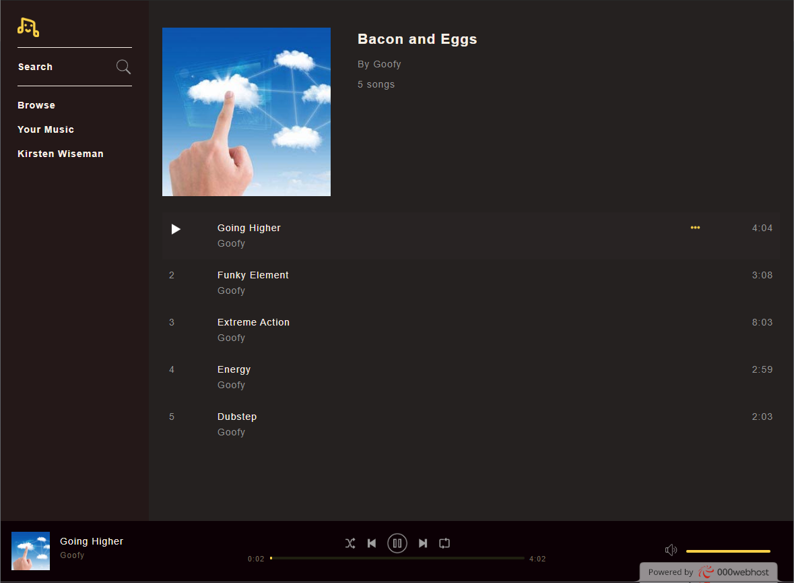
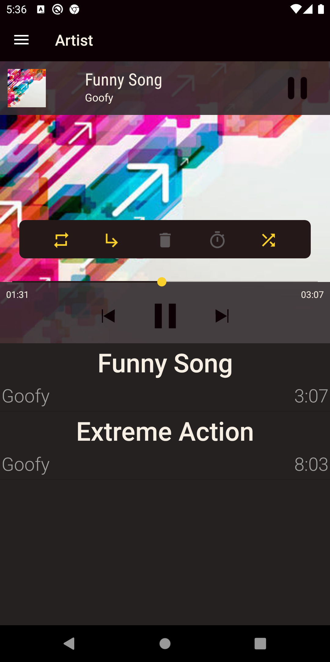
Music streaming from a web-server to an Android app & Website
By: Imran Shaikh & Shriraj Pethe
Towards The Partial Fulfilment of the Master of Computer Application

Slide 2
INTRODUCTION
Streaming media is multimedia that is constantly received by and presented to an end-user while being delivered by a provider.
Streaming is different than traditional file downloads.
The user doesn’t have to wait till the file is completely received.
Currently Music Streaming services are very popular. Despite having free options users prefer to get paid subscriptions to Music Streaming services.
In our project we have created a server based streaming service, which is accessible via our Android App & our Website.

Slide 3
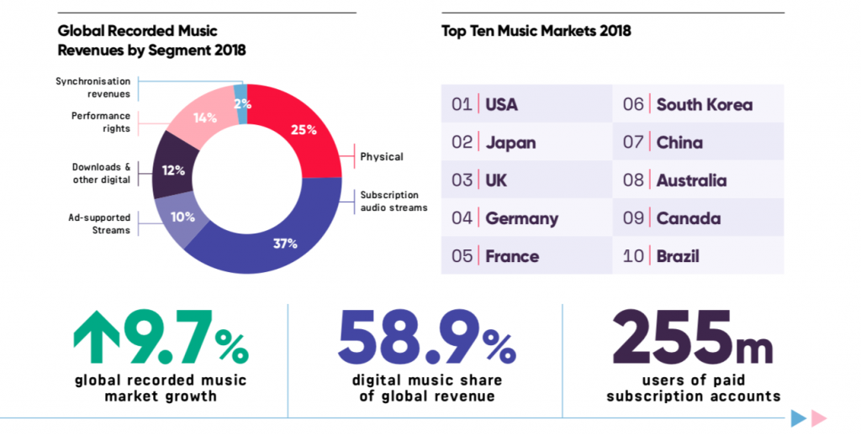
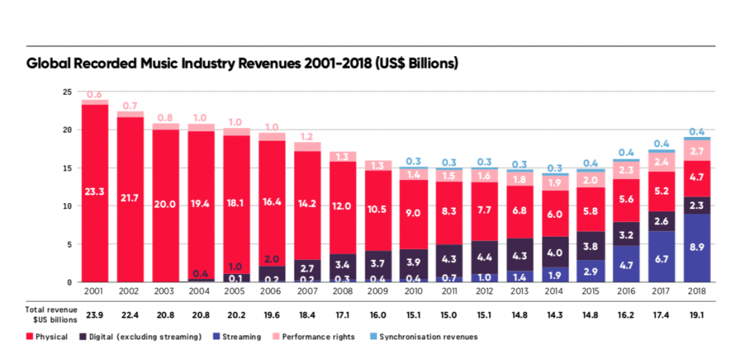
STATISTICS
India is considered at 15th place.

Slide 4
GOALS
In this project we have explored popular music streaming services. And we will be making our project to provide similar service to our website and android app users.
The leading music streaming services like Spotify, gaana.com, and Pandora have become that popular because they’re simply convenient and offer good value for money.
However, in order to create a music streaming app, we need to consider various factors like music license, platform, technology, implementation about these services.
In our project we have attempted to provide all the essential as well as some advance features, which are present in some music streaming services.

Slide 5











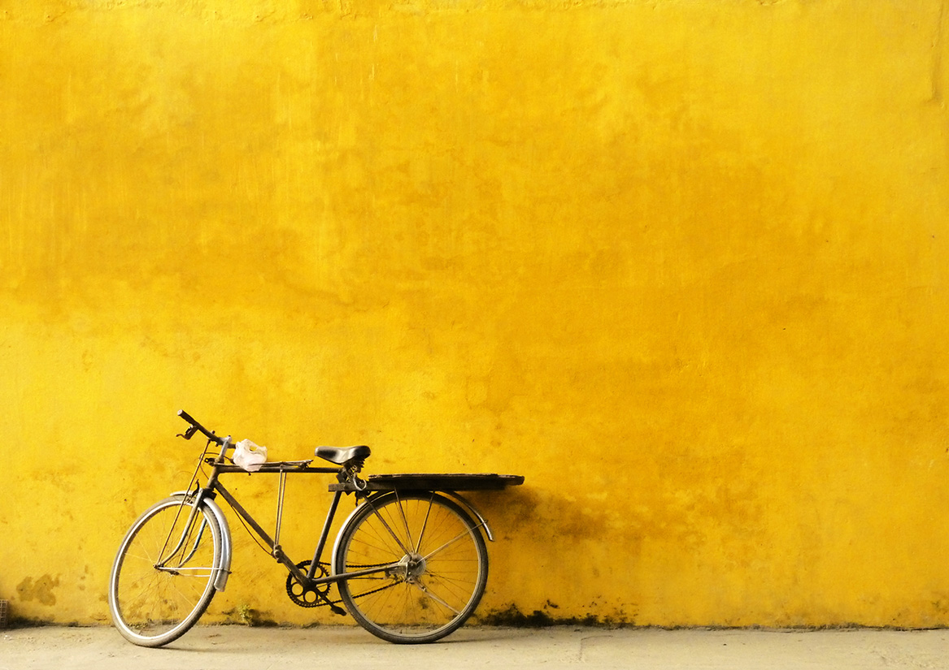
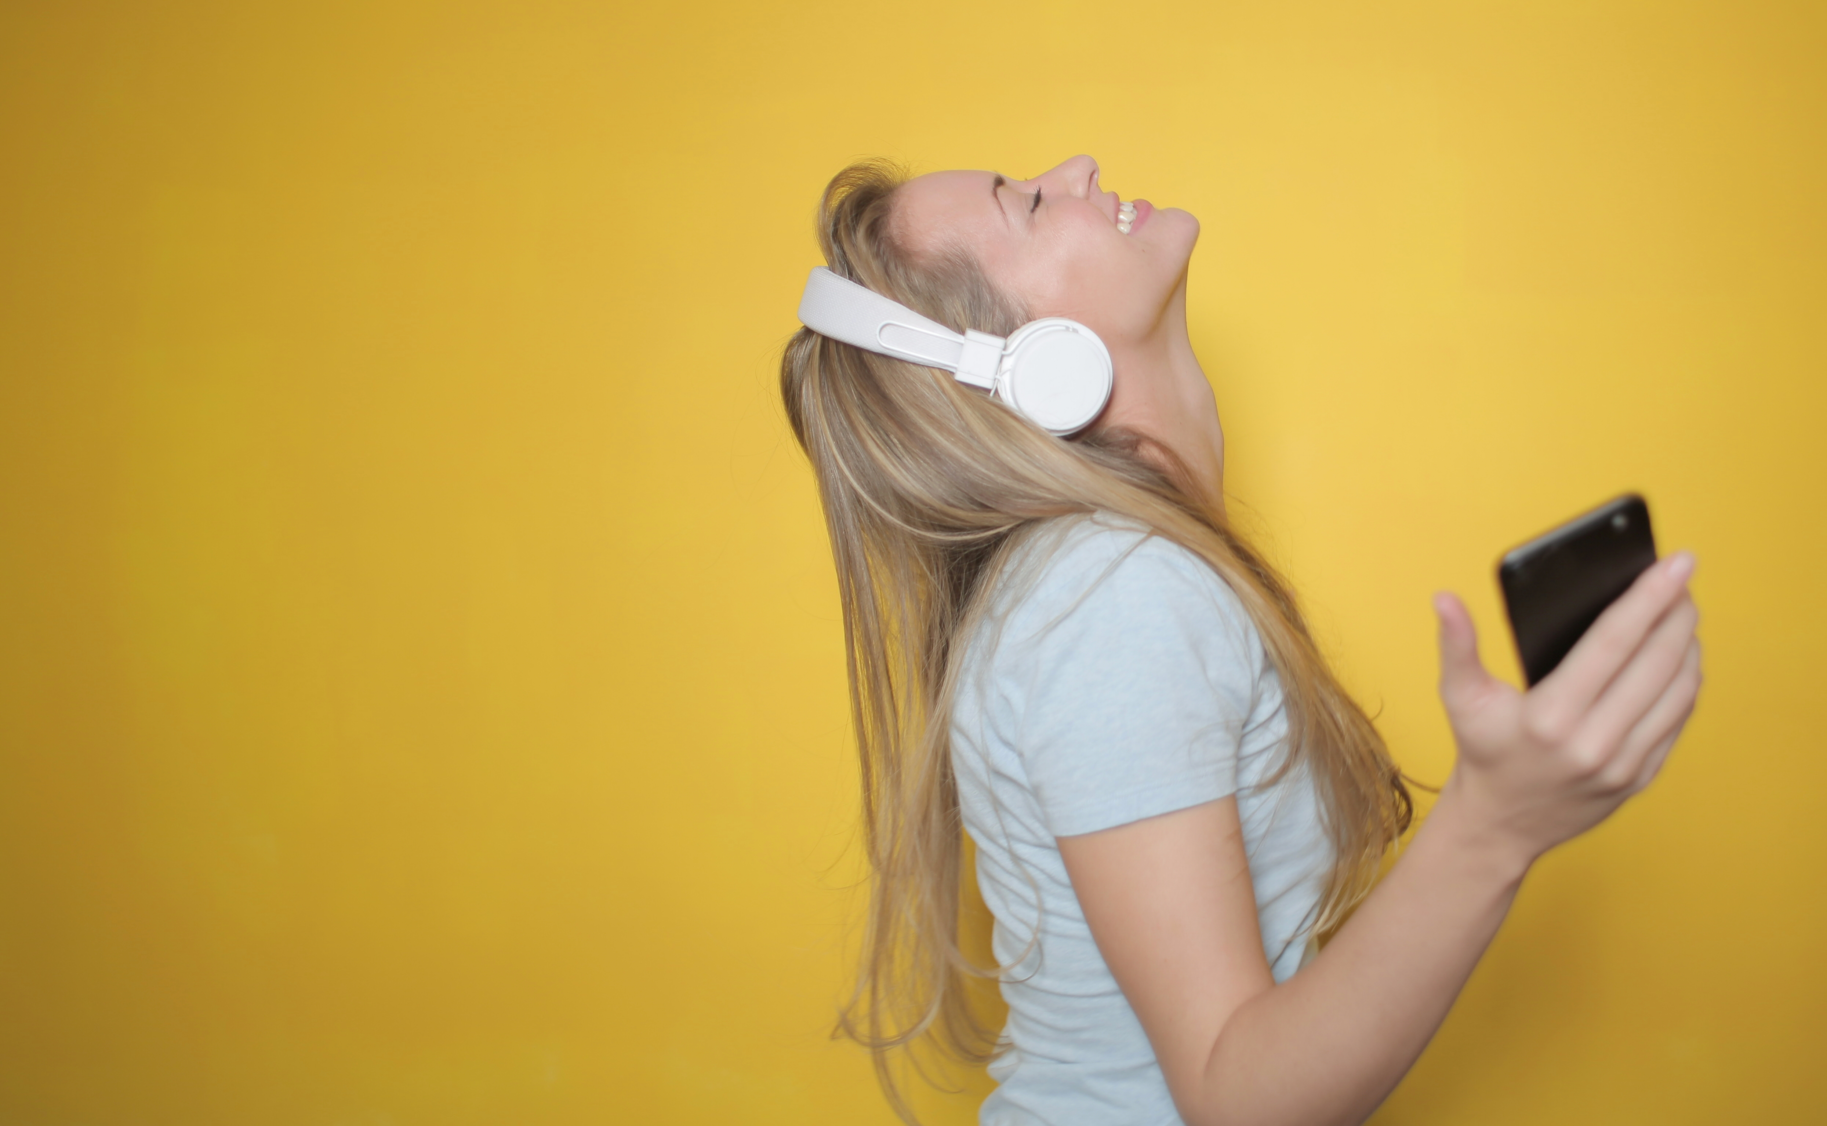
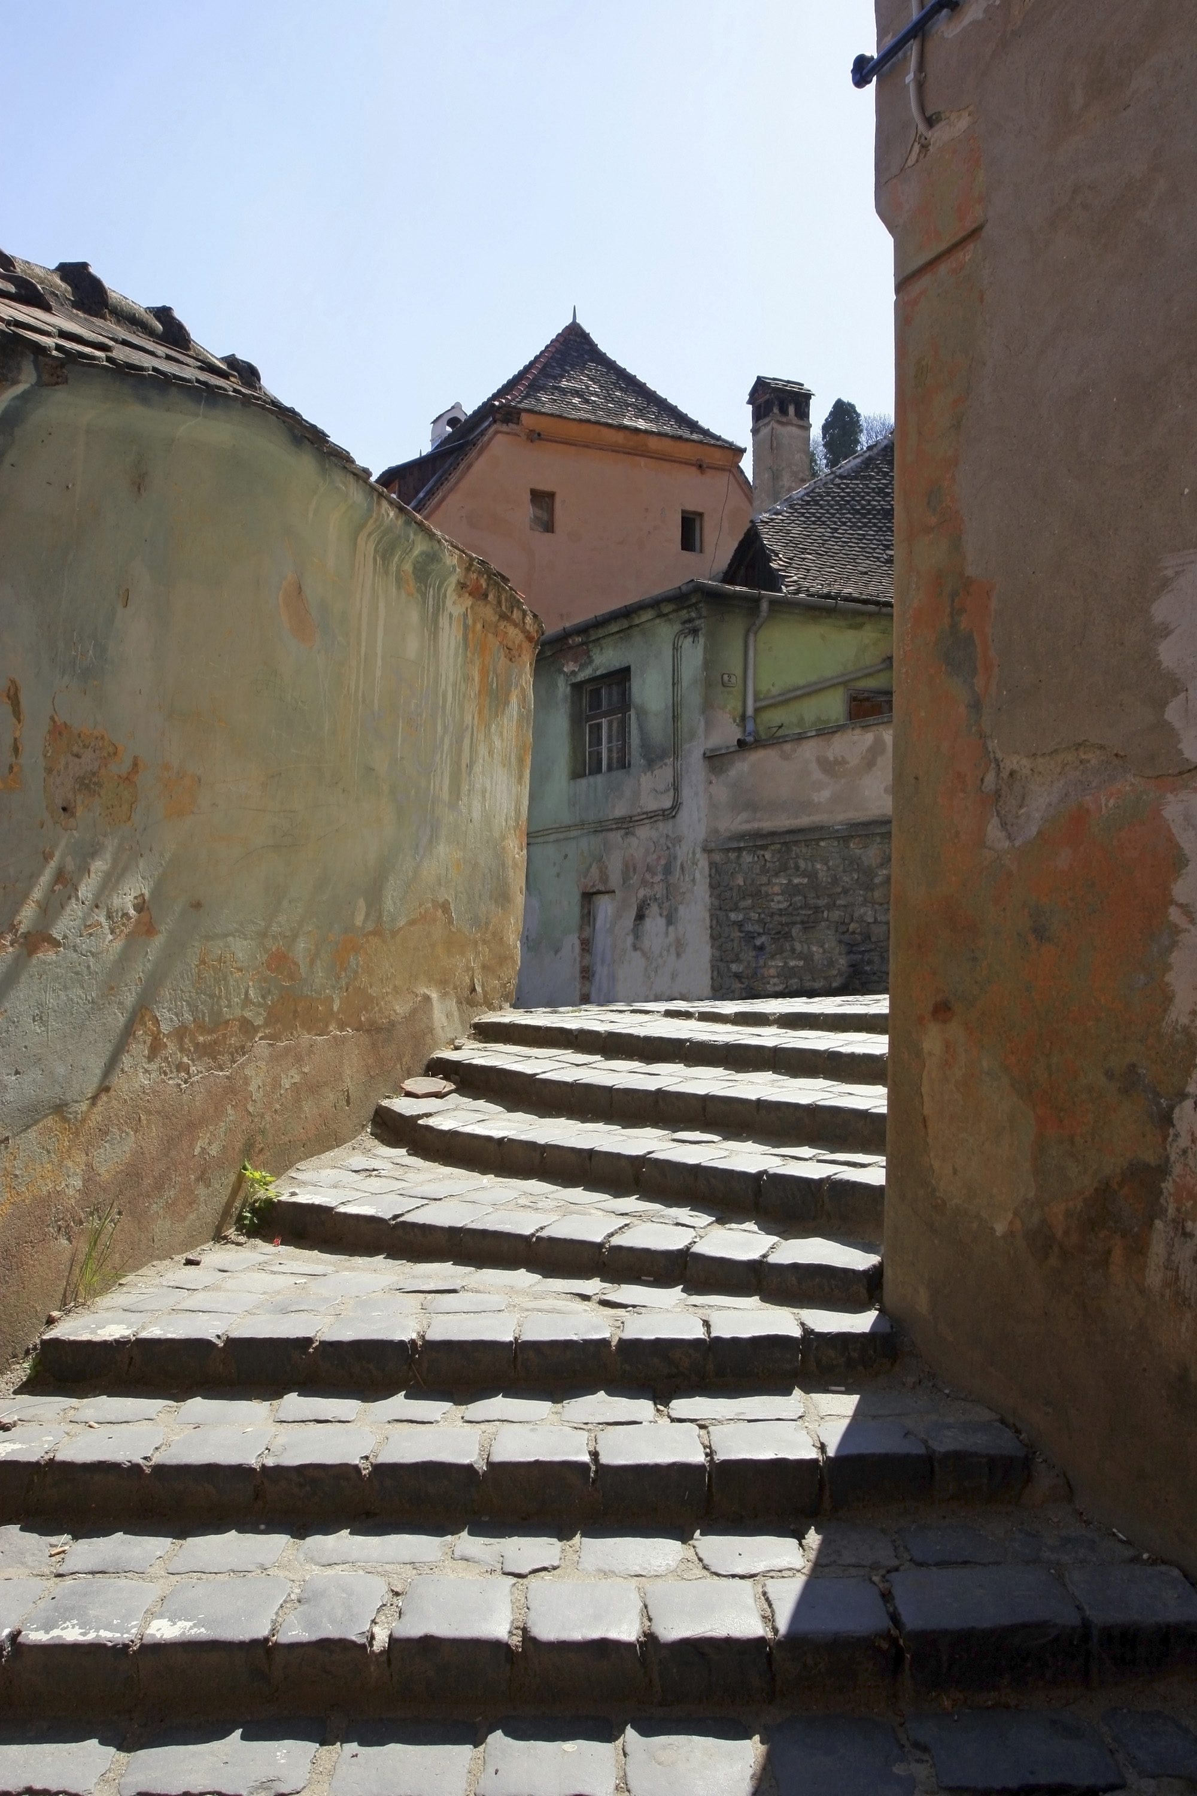
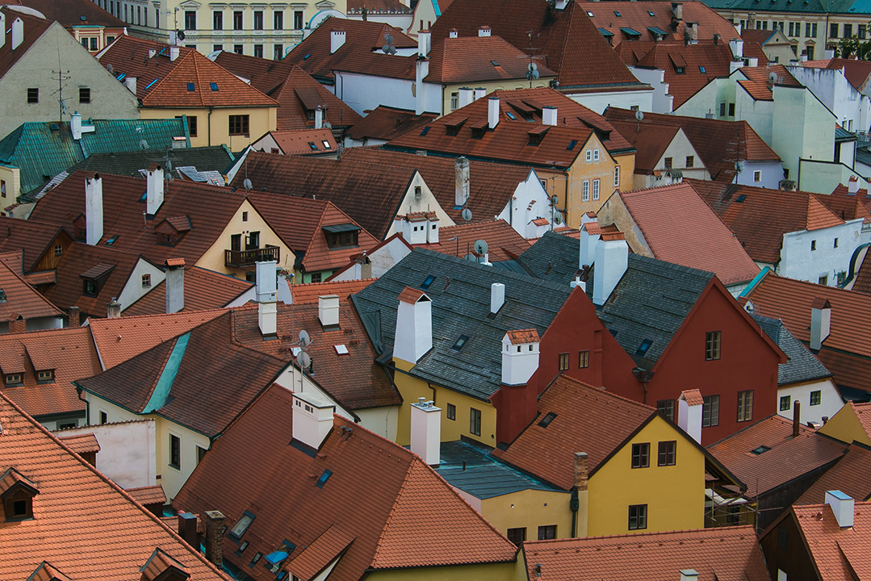
MODULES / FEATURES
Music player
User registration and editing user profile
Search functionality
Browsing via categories
Playlists
Settings

Slide 6
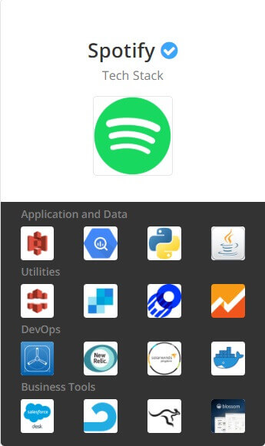
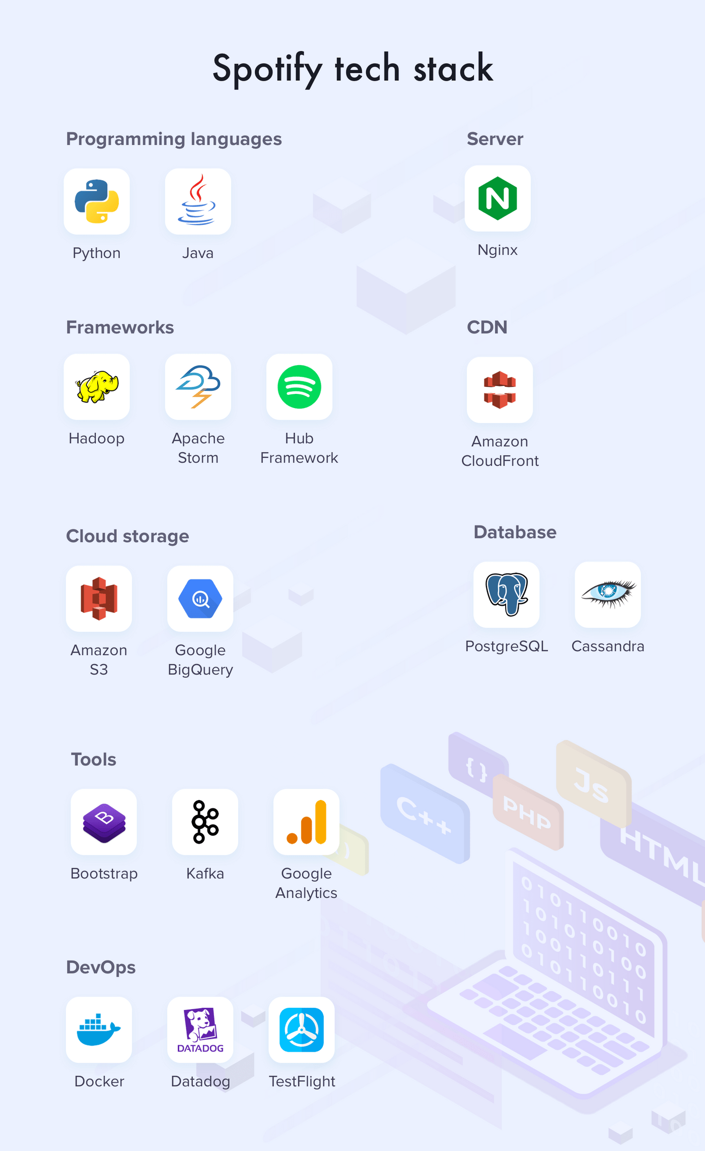
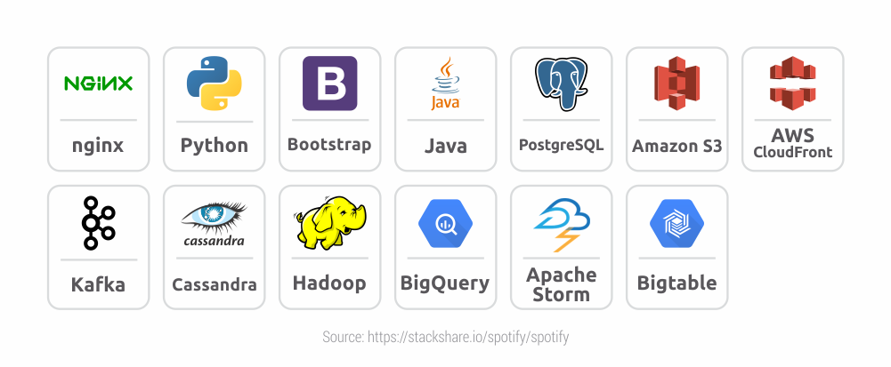
TECHNOLOGY STACK -SPOTIFY
This data is from internet, based on estimation, and expert opinion.
Fun fact: when Spotify started they were also using P2P architecture.

Slide 7
TECHNOLOGY STACK -OUR PROJECT
Programming languages:
Java
PHP
AJAX
JS
Server:
XAMPP Stack
Unix Socket
PHP engine
Database:
MariaDB on UNIX socket
Storage:
000webhost server based limited storage
Front End Web
HTML
CSS
JS
AJAX
Android Application:
Java
XML for android design
Android Libraries:
androidx
MDC
amitshekhar.android:android-networking
picasso:2.71828
sothree.slidinguppanel:library:3.4.0

Slide 8
REQUIREMENTS
Android (For App):
Android API 28 (Android 9.0) or better.
Android (For App):
3 GB of ram or more.
8 GBs of free space.
Preferred SOC: MediaTek Helio P22 MT6762
6 or more cores preferred.
Communication module(s):
WLAN OR LTE / Cellular Data.
For Web version (For Website):
Any HTML5 supported modern Web browser.
Chromium based browser preferred.
Preferably Desktop browser.
For Web version (For Website) Desktop preferred:
4 GB of ram or more.
6 GBs of free space.
Dual-Core CPU (Intel 3 rd generation or above).
Communication module(s):
WLAN OR LAN.

Slide 9
ESTIMATION OF TIME FOR THE DEVELOPMENT OF VARIOUS FEATURES
Feature / Module | Back-end + (web) front-end | Android
Registration, Login | 35 hours | 10 hours
Search | 24 hours | 50 hours
Music player | 24 hours | 16 hours
My music | 83 hours | 140 hours
Settings | 35 hours | 30 hours

Slide 10
TECHNOLOGY THAT WE HAVE USED
Android OS
JAVA
Android SDK
Dalvik VM / ART
Android Studio
XML
Androidx
MDC
amitshekhar.android:android-networking
picasso:2.71828
sothree.slidinguppanel:library:3.4.0
PHP
AJAX
JavaScript
XAMPP
UNIX socket
MySQL
MariaDB
HTML5
CSS
jQuery

Slide 11
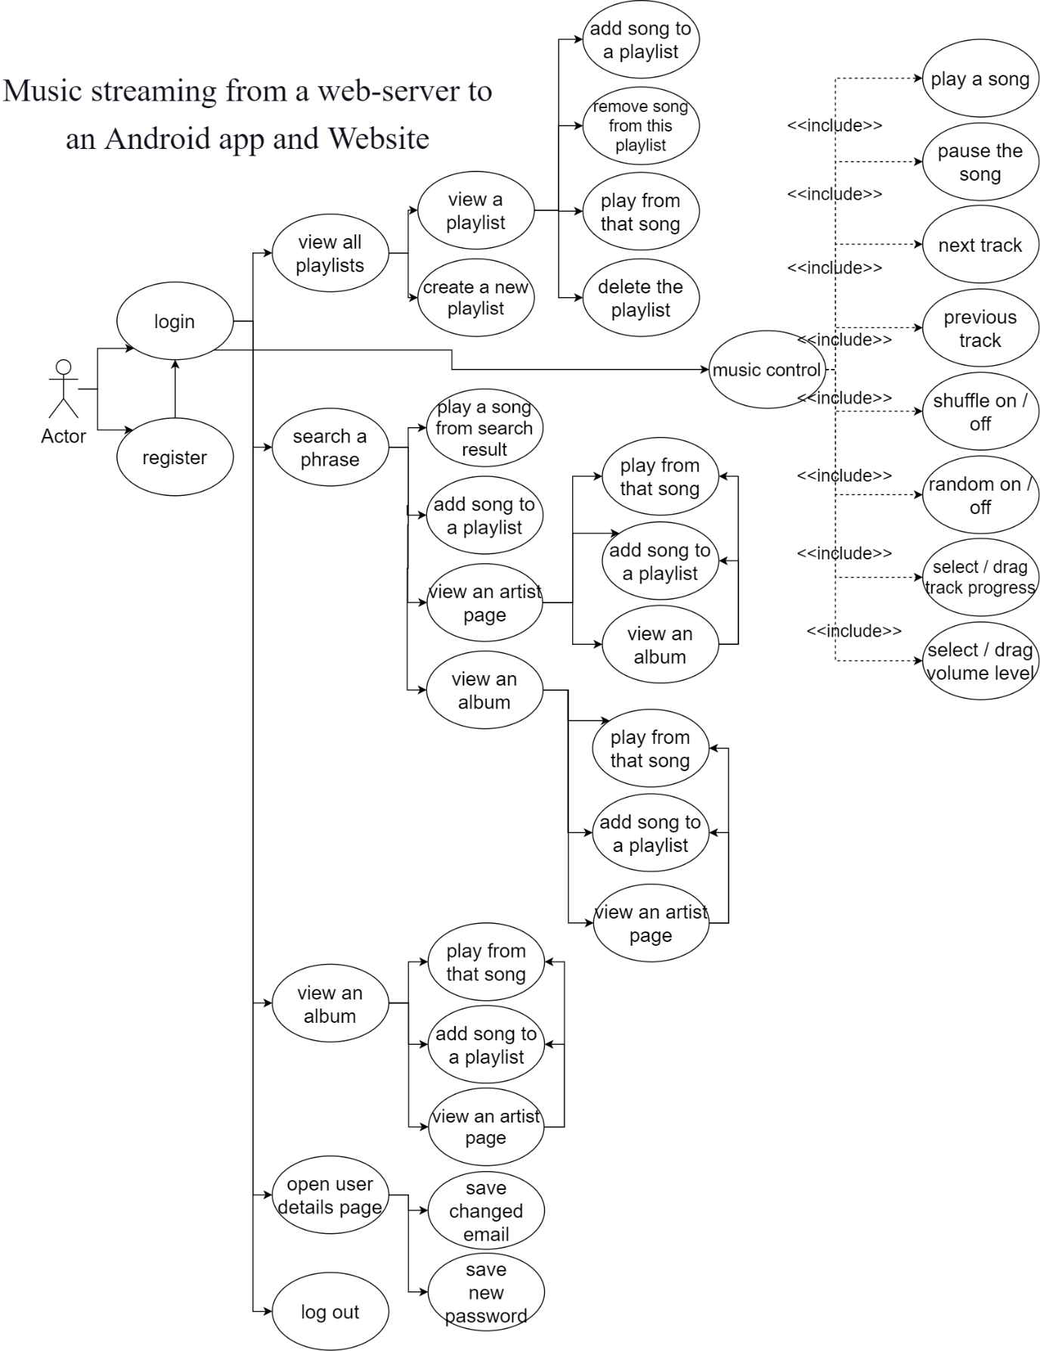
USE CASE DIAGRAM

Slide 12
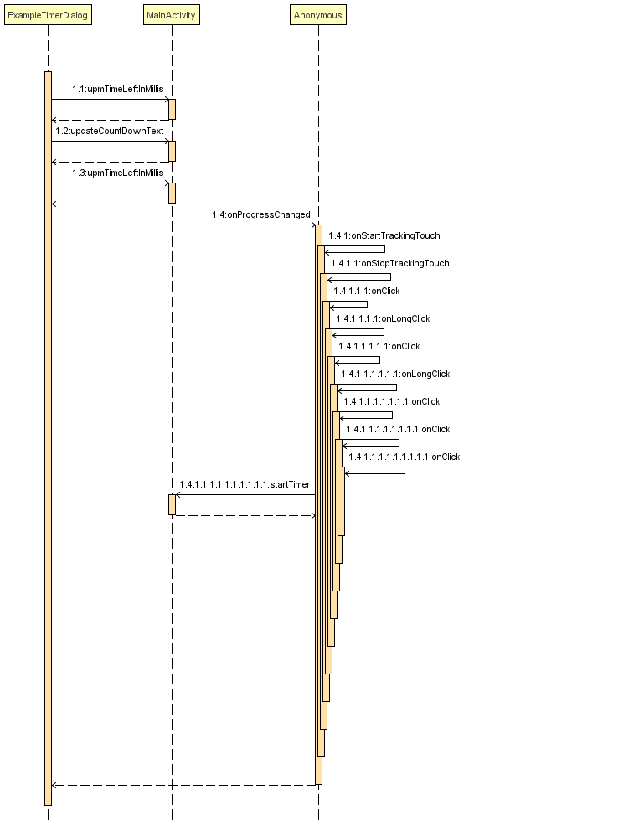
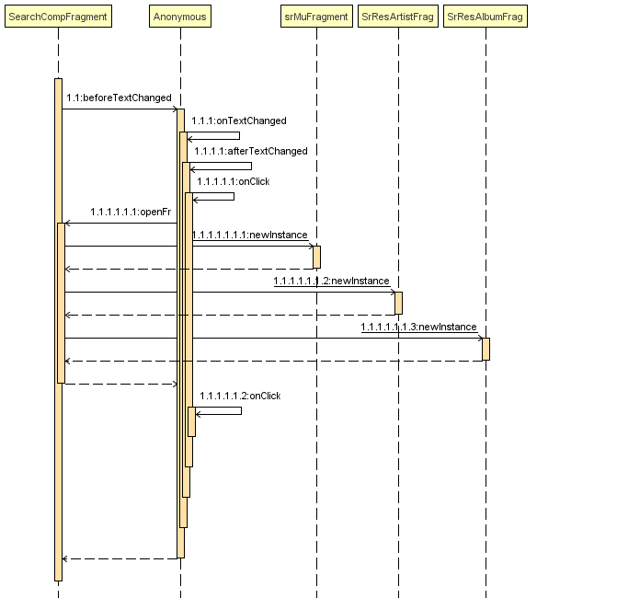
SEQUENCE DIAGRAM
Search Fragment
(Android)
Auto Stop Timer
(Android)

Slide 13
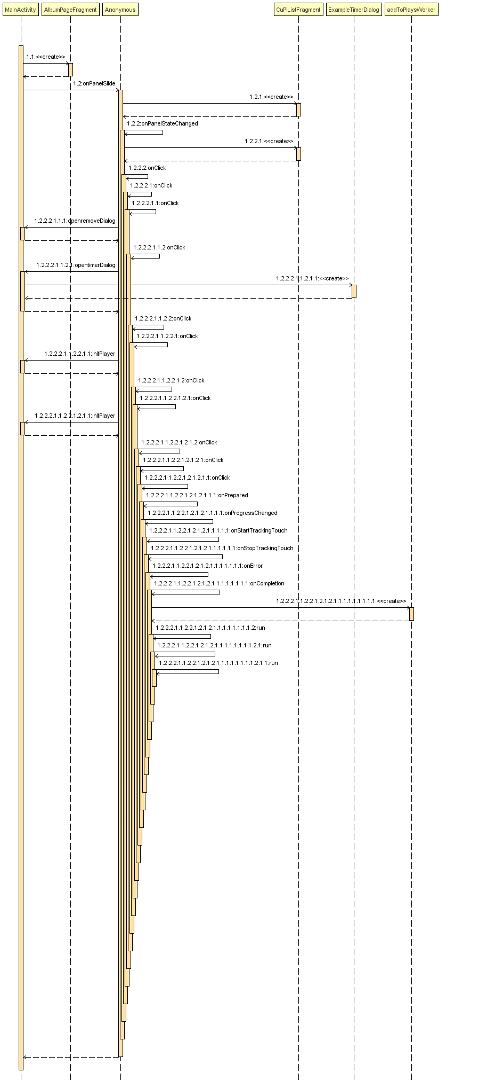
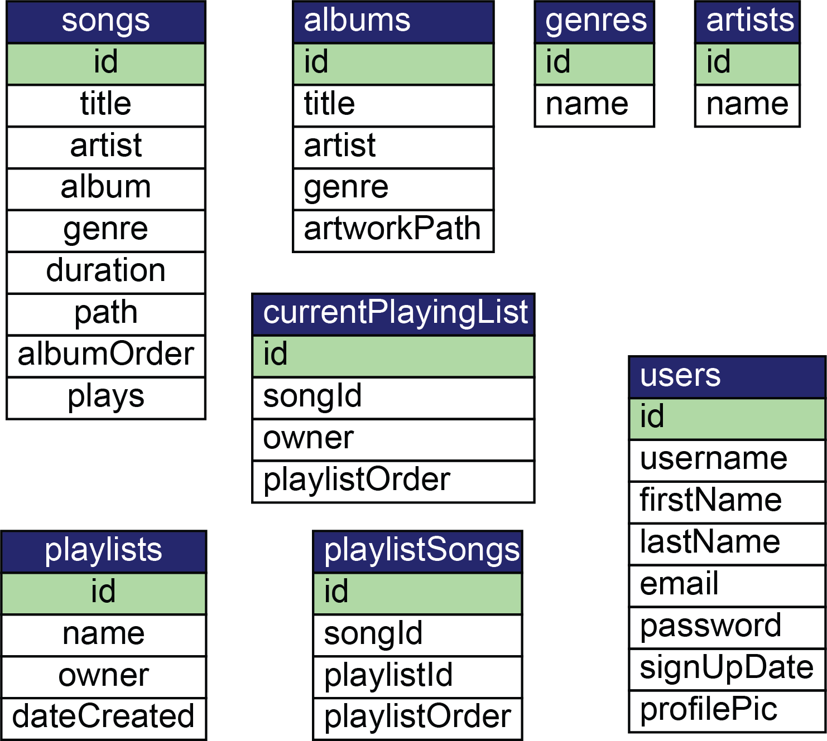
DIAGRAMS
Database
Tables
MainActivity

Slide 14
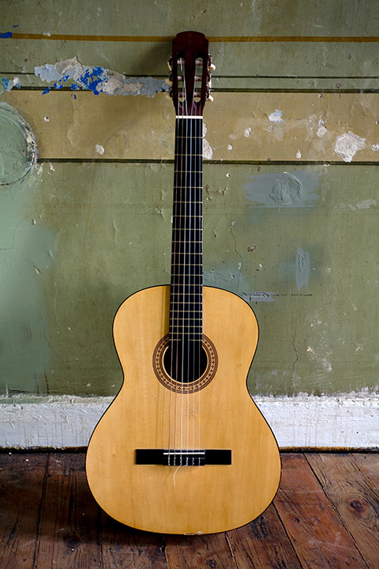
LIMITATIONS
Our server isn’t considered as a Streaming quality server.
Noticeable delay.
We aren’t using streaming dedicated solutions.
Some bugs may be present.
May lack a few advanced functions.

Slide 15

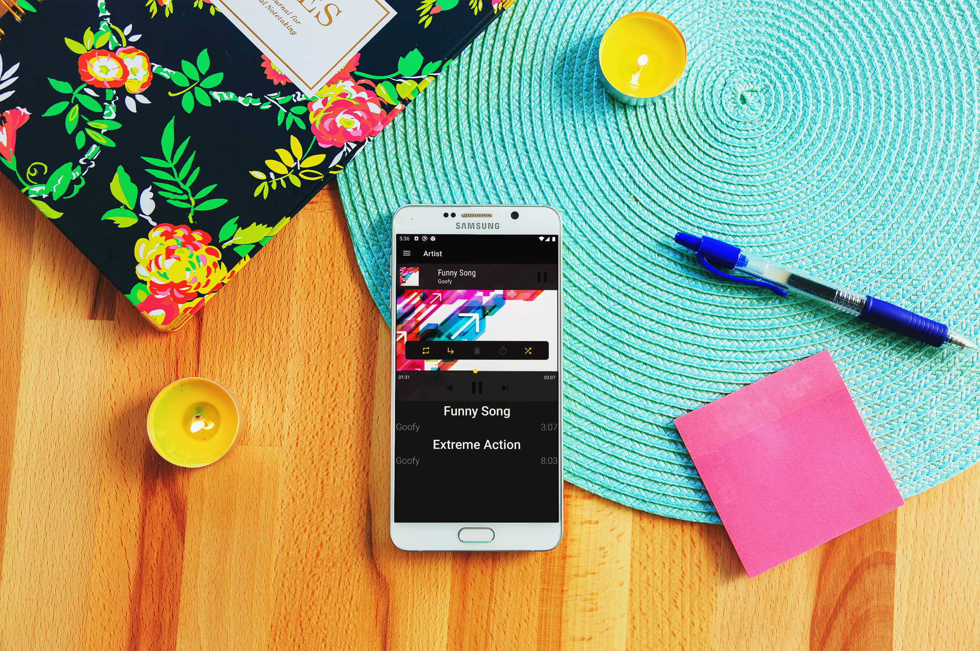
APPLICATION AND FUTURE SCOPE
This was a demonstrational project, and hence the goal was achieved.
We plan to advance this project, and add audiobooks from services like, LibriVox, who produce audio narration for literature which is copyright free, or copyright expired, or is available in public domain. They largely focus on AudioBooks.
Because of democratisation of technology, any one with interest, internet, and a Computer can produce music. There are many new and upcoming artist who rather prefer to keep their music compositions and tracks without any limitation of royalty.

Slide 16
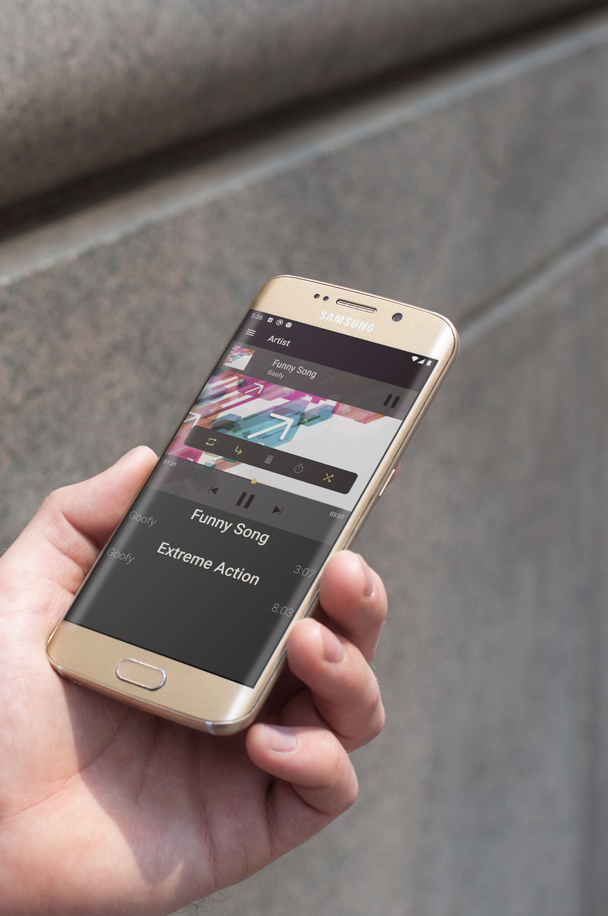
CONCLUSION
While our project may not be considered as a production grade software.
This project can be considered as an early stage under development project.
And can be used by users.

Slide 17

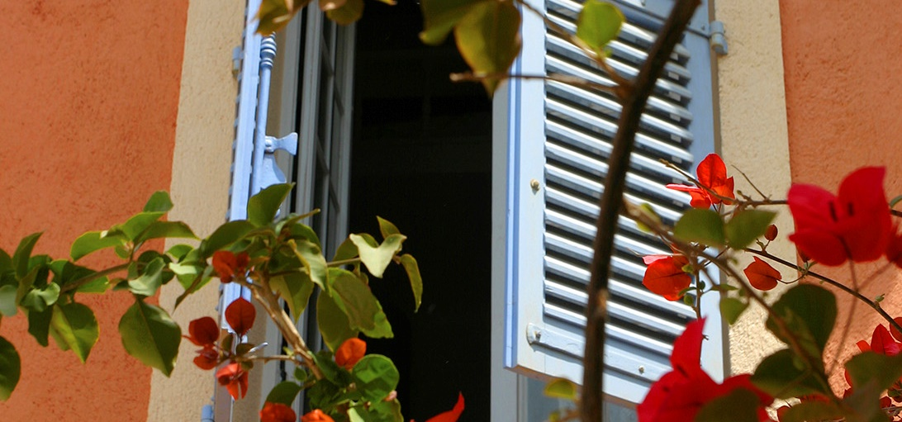
Thank You!
धन्यवाद!

